Slide 1

Named Entity Recognition for a Large-Scale Analysis of Individuals in Antiquity
Marijke Beersmans, Alek Keersmaekers, Evelien de Graaf, Tim Van de Cruys, Margherita Fantoli
Notes:
Good morning everyone, my name is Marijke Beersmans, I am a PhD

Slide 2
Overview
Introducing NIKAW
Introducing Named Entity Recognition (NER)
NER on Latin
Data
Methods
Results
NER on Ancient Greek
Data
Methods
Regular NER
Modifications to find people
Results
Conclusion, limitations and moving forward
Notes:
What follows is overview of the presentation. First, I will introduce the overarching project that

Slide 3
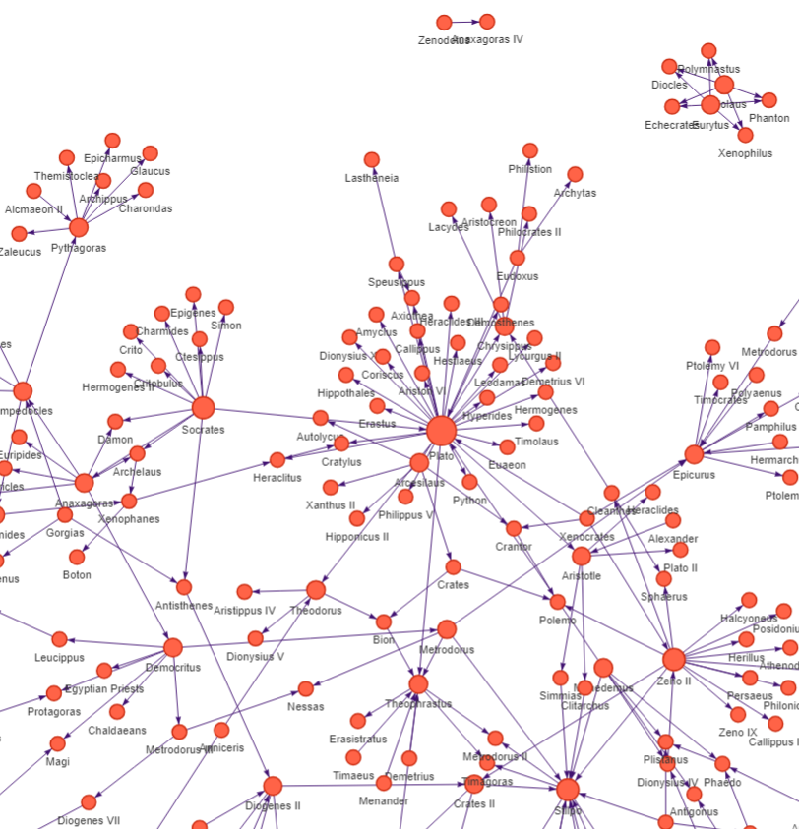
NIKAW
Networks of Ideas and Knowledge in the Ancient World
Funded by KU Leuven
Study the flow of ideas in a large corpus of Ancient Greek and Latin texts
From 8th century BC to the 6th century CE
Step 1: find the mentions of people
Named Entity Recognition
Visualised – a network of Ancient Greek intellectuals
(Diogenet – Intellectual Networks of the Ancient World, https://diogenet.ucsd.edu)

Slide 4
Named Entity Recognition (NER)
In unstructured text, find references to “rigid designators” and classify them into the correct type.
PERS, LOC, GRP/NORP, MISC
Challenging for Classical Languages
Closed & fragmented corpus
But:
Domain knowledge: gazetteers (e.g. Trismegistos)
Critical editions
Increasing interest

Slide 5
NER on Latin

Slide 6
Data
Herodotos project (Erdmann et al., 2016, 2019)
Training: prose texts
Testing: 12,5% of prose texts (in domain) and 1 poetry text (out of domain)
Text | # tokens | Domain | Period | Genre
Caesar‘s De Bello Gallico | 58.621 | IN | 1st century BC | Commentary
Pliny the Elder’s Naturalis historia (excerpt) | 35.672 | IN | 1st century AD | Encyclopedia
Pliny the Younger‘s Epistulae (excerpt) | 18.571 | IN | 1st century BC | Letters
Caesar’s Bello Civile (excerpt) | 4.819 | IN | 1st century BC | Commentary
Ovid‘s Ars Amatoria | 17.102 | OUT | 1st century AD | Elegy (poetry)

Slide 7
Data
Newly annotated data
Texts | # tokens | Domain | Period | Genre
Tacitus’ Historiae 1 | 11.983 | IN | 2nd century AD | Historiography
Cicero’s Orationes Philippicae 1 | 3.754 | IN | 1st century AD | Speeches
Juvenal’s Saturae 1-3 | 4.399 | OUT | 2nd century AD | Satiric poetry

Slide 8
Methods
Baseline: Herodotos Bi-LSTM-CRF (Erdmann et al., 2016)
LatinBERT transformer (Bamman and Burns, 2020):

Slide 9
Notes:
PERS is best understood category
LB2 scores the highest
Poetry is extremely difficult, word order,

Slide 11
Results
Error analysis (by Evelien de Graaf)
Boundary detection
Lists: Gracchis et Catoni Pollionem Caesarem Caelium (Ep. 1.20.4) - three separate entities predicted as one
Rare/unclear in training data
Foreign names: Adadu, Calymne, Therapnaeus, Andromeda etc.
GRP/LOC unclear: neque enim conferendum esse Gallicum [B-LOC] cum Germanorum [B-GRP] agro (GW, 1.31) ‘for there can be no comparison between the Gallic and the German territory’
Prediction: GRP for both
Tokens that occur both as entity and non-entity: Pax (Goddess) / pax (peace)

Slide 12
NER on Ancient Greek

Slide 13
Data
Text | # tokens | annotation method | credit | Period | Genre
Pausanias’ Periegesis Hellados | 242.433 | Manual | Foka et al., 2021 | 2nd century AD | Travelogue
Anathenaeus of Naucratis’ Deipnosophists | 314.256 | Semi-automatic | Perseus project (urn:cts:greekLit:tlg0008.tlg001.perseus-grc4), 2015 | 3rd century AD | Dialogue with Encyclopedic information
Homer’s Odyssey | 104.364 | Manual | Kemp, 2021 | 8th century BC | Epic poetry
The Greek New Testament | 158.325 | Manual | STEPBible Data Repository CC BY 4.0, 2018/2023 by www.Stepbible.org | 1st -2nd century AD | Religious

Slide 14
Newly annotated data
GLAUx corpus
Greek literature between 8th century BC and the 4th century CE
27 million tokens
annotated for morphology, lemmas and syntax (manual/automatic)
Randomized sample of 596 sentences, annotated for NER

Slide 15
Methods
Homogenize the data
Transformer models
Model | credit | size | languages
AG_BERT | Singh et al., 2021 | 768 | Modern Greek, Ancient Greek
Electra | Mercelis and Keersmaekers, 282 2022) | 256 | Ancient Greek
Grεberta | Riemenschneider and Frank, 286 2023 | 768 | Ancient Greek
UGARIT | Yousef et al., 2022 | 768 | Multilingual, Ancient Greek

Slide 16
Notes:
And these are the results of the normal Named Entity Recognition. As you can see, AG-BERT and UGARIT score the best, but overall the performances are quite close.

Slide 17
Modifications to find People
Simplified task PERS/MISC
Only on capitalized words
PERS entities => PERS
Everything else => MISC
Notes:
Many critical editions do not use sentence initial capitalization and basically only capitalize something when it is an entity of some kind. This is also the policy of the GLAUx corpus.

Slide 19
Modifications to find People
Gazetteer incorporation (Trismegistos)
if it is in the TM gazetteer for names (NamVar), but not in the TM gazetteer for places (GEOVAR) it is a PERS
post-processing rule
binary mask (0-1) added to the model input

Slide 21
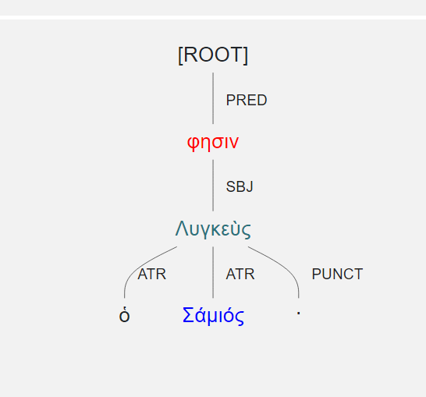
Modifications to find People
Multiword people, e.g. Lycneus the Samian rare and scarcely annotated in training data
In GLAUx-data: less then 1 in 10 continuation words are predicted correctly
Multiword people based on syntactic dependencies
Annotate the sentence structure
Which words belong together?
Dependency tree for “Lycneus the Samian”

Slide 23
Results
Error analysis (by Evelien de Graaf)
Tokens that occur both as entity and non-entity: : Λύχνος (deity)/λύχνος (‘candle’/’lamp’)
Rare/unclear in training data
Names of lines, angles, points in mathematical texts… e.g. ΖΒ
Nicknames: Κακεργέτης (‘Evildoer’)
Gazetteer incorporation brings small improvement, but
Matching too strict
Syntax shows improvement for multiword entities, but:
Mainly propagation errors

Slide 24
Conclusion
Transformers hold up as the state-of-the-art approach
Recurring errors
Boundary detection
Unclear/rare in training data
Genuine ambiguity
Domain knowledge and syntax can help, but
Matching too strict
Syntax suffers from propagation errors

Slide 25
Sources
STEPBible Data Repository CC BY 4.0. (2023). [Computer software]. www.STEPBible.org. https://github.com/STEPBible/STEPBible-Data (Original work published 2018)
Bamman, D., & Burns, P. J. (2020). Latin BERT: A Contextual Language Model for Classical Philology (arXiv:2009.10053). arXiv. https://doi.org/10.48550/arXiv.2009.10053
Broux, Y., & Depauw, M. (2015). Developing Onomastic Gazetteers and Prosopographies for the Ancient World Through Named Entity Recognition and Graph Visualization: Some Examples from Trismegistos People. In L. M. Aiello & D. McFarland (Eds.), Social Informatics (pp. 304–313). Springer International Publishing. https://doi.org/10.1007/978-3-319-15168-7_38
Alexander Erdmann, Christopher Brown, Brian Joseph, Mark Janse, Petra Ajaka, Micha Elsner, and Marie-Catherine de Marneffe. 2016. Challenges and Solutions for Latin Named Entity Recognition. Proceedings of the Workshop on Language Technology Resources and Tools for Digital Humanities (LT4DH), 85–93.
Erdmann, A., Wrisley, D. J., Allen, B., Brown, C., Cohen-Bodénès, S., Elsner, M., Feng, Y., Joseph, B., Joyeux-Prunel, B., & de Marneffe, M.-C. (2019). Practical, Efficient, and Customizable Active Learning for Named Entity Recognition in the Digital Humanities. Proceedings of the 2019 Conference of the North American Chapter of the Association for Computational Linguistics: Human Language Technologies, Volume 1 (Long and Short Papers), 2223–2234. https://doi.org/10.18653/v1/N19-1231

Slide 26
Sources
Foka, A., McMeekin, D. A., Konstantinidou, K., Mostofian, N., Barker, E., Demiroglu, O. C., Chiew, E., Kiesling, B., & Talatas, L. (2021). Mapping Ancient Heritage Narratives with Digital Tools. In E. M. Champion (Ed.), Virtual Heritage: A Concise Guide (pp. 55–65). Ubiquity Press. https://doi.org/10.5334/bck.f
Kemp, J.. (2021, September 3). Beyond Translation: Building Better Greek Scholars. Pelagios. https://medium.com/pelagios/beyond-translation-building-better-greek-scholars-561ab331a1bc
Mercelis, W and Keersmaekers, A.. (2022), electra-grc. Retrieved March 17, 2023, from https://huggingface.co/mercelisw/electra-grc
Riemenschneider, F., & Frank, A. (2023). Exploring Large Language Models for Classical Philology. Proceedings of the 61st Annual Meeting of the Association for Computational Linguistics (Volume 1: Long Papers), 15181–15199. https://doi.org/10.18653/v1/2023.acl-long.846
Singh, P., Rutten, G., & Lefever, E. (2021). A pilot study for BERT language modelling and morphological analysis for ancient and medieval Greek. Proceedings of the 5th Joint SIGHUM Workshop on Computational Linguistics for Cultural Heritage, Social Sciences, Humanities and Literature (LaTeCH-CLfL 2021), 128–137. http://hdl.handle.net/1854/LU-8726146

